Slide 1


Experiment 4
Wye-Delta Transformer – Ungrounded System
Unbalanced Load
Dr. Norbert Doerry and Dr. John V. Amy Jr.
http://doerry.org/norbert/MarineElectricalPowerSystems/index.htm
© 2024 by Norbert Doerry and John Amy
This work is licensed via: CC BY 4.0 (https://creativecommons.org/)

Slide 2

Schematic
$$V_{secondary_ll}=\frac{1}{n\sqrt{3}}V_{primary}=\frac{1}{5.2\sqrt{3}}208=23 volts rms (32.7 peak)$$
$$I_{secondary}=n\sqrt{3}I_{primary}$$
(Neglecting losses)
C_{p} = 2.2 µF
R = 1200 Ω
R_{L} = 300 Ω
R_{La} = 200 Ω
R_{lamp} = 450 Ω
N = 5.2
R_{lamp}
Common Mode Current Probe
Current Meter (all phases)
Voltage Meter (all phases)

Slide 3
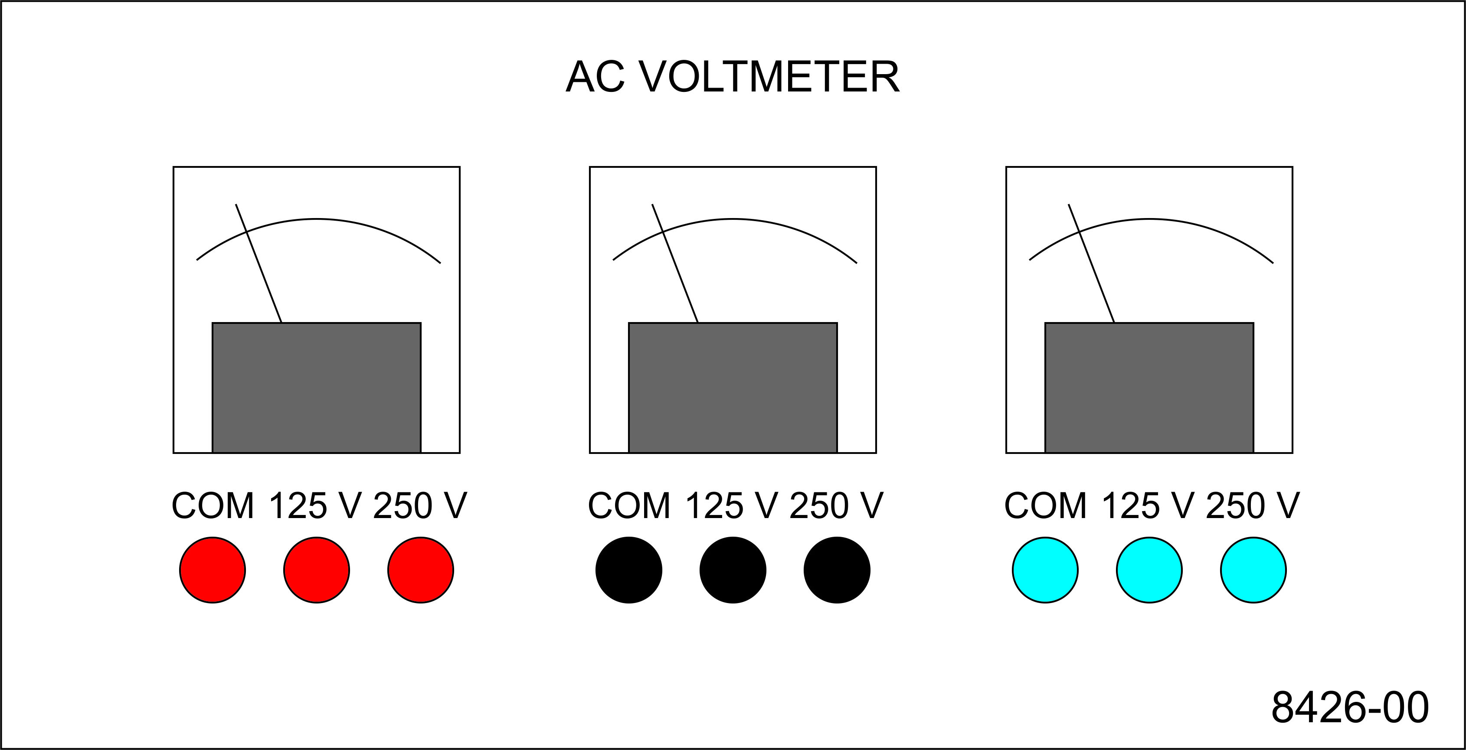
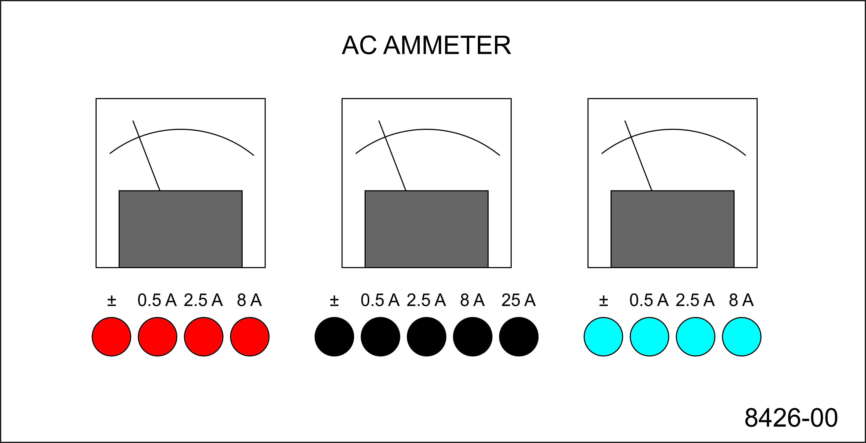
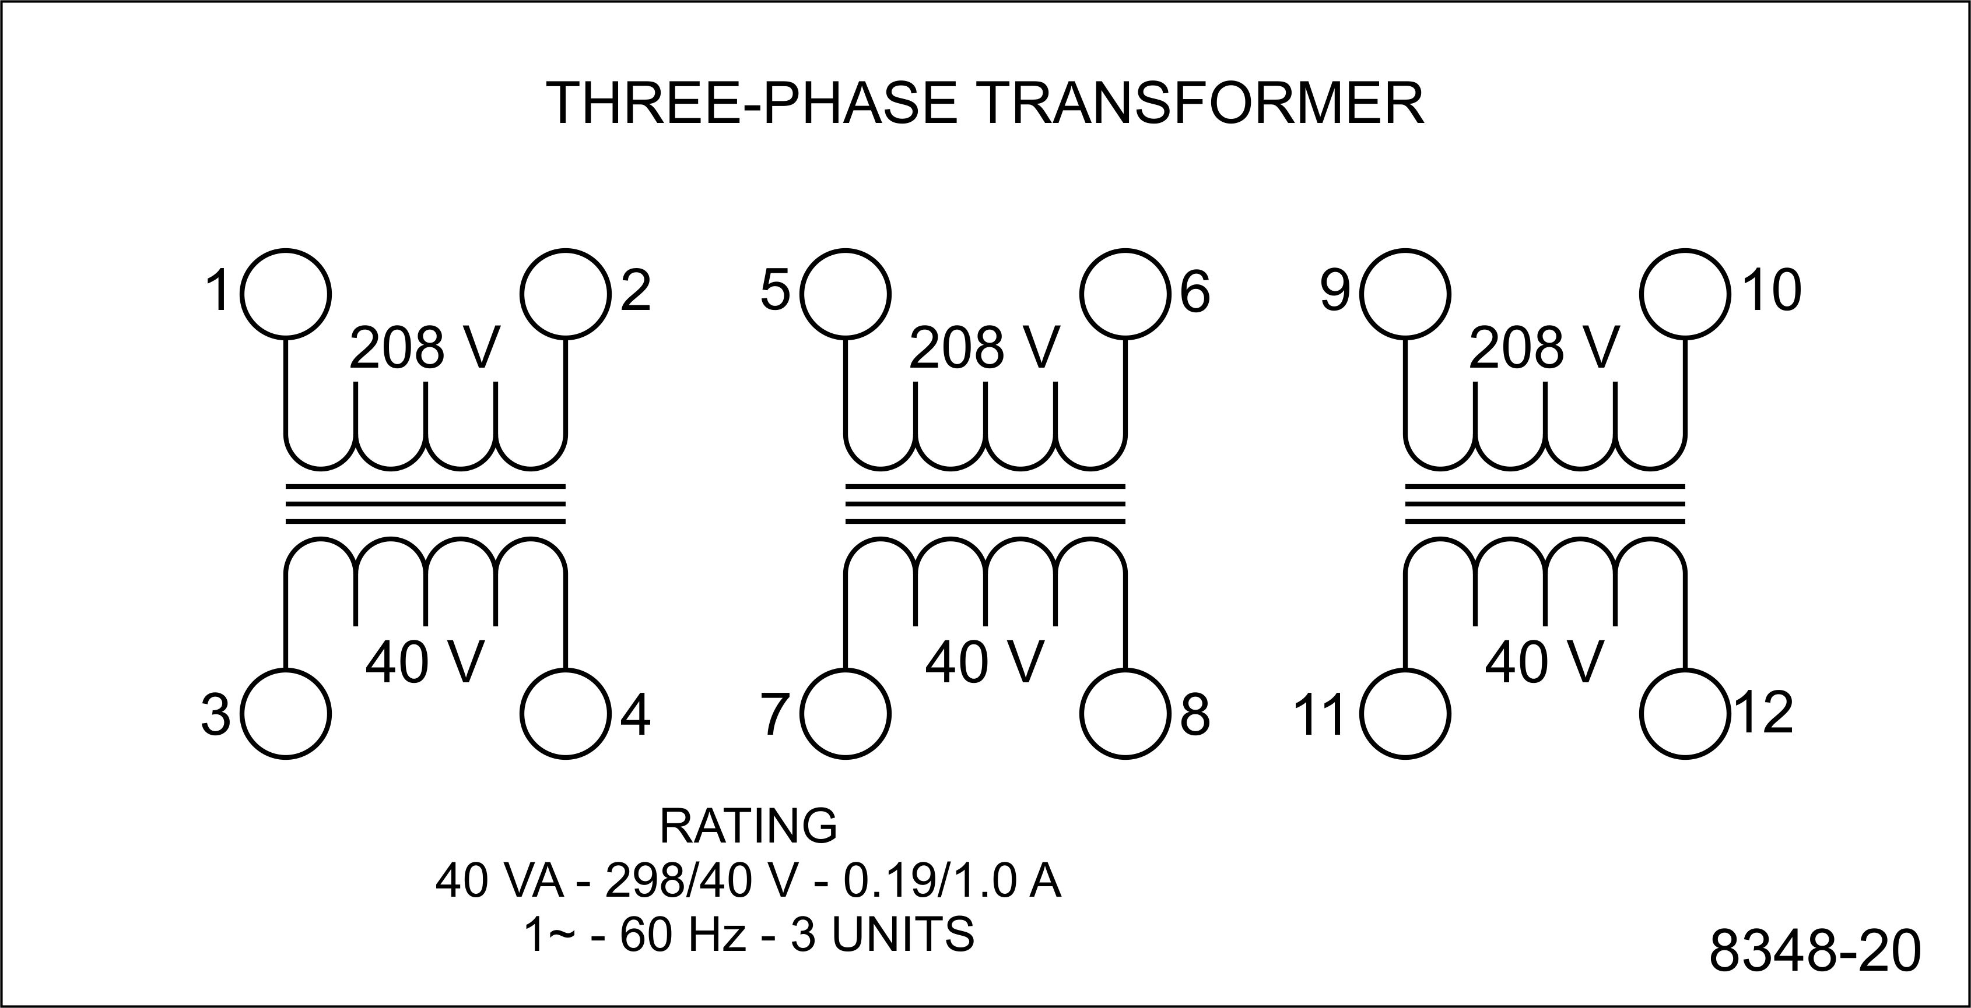
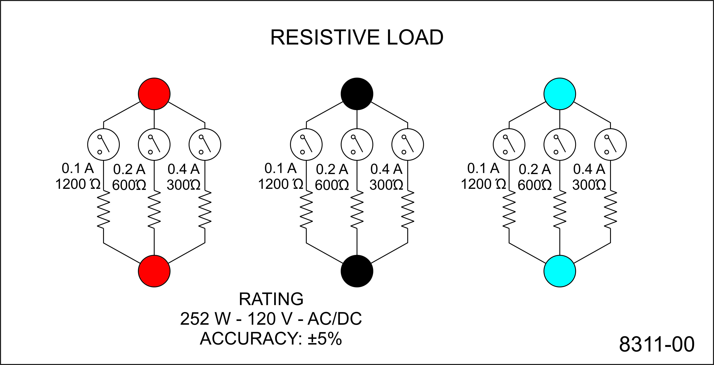
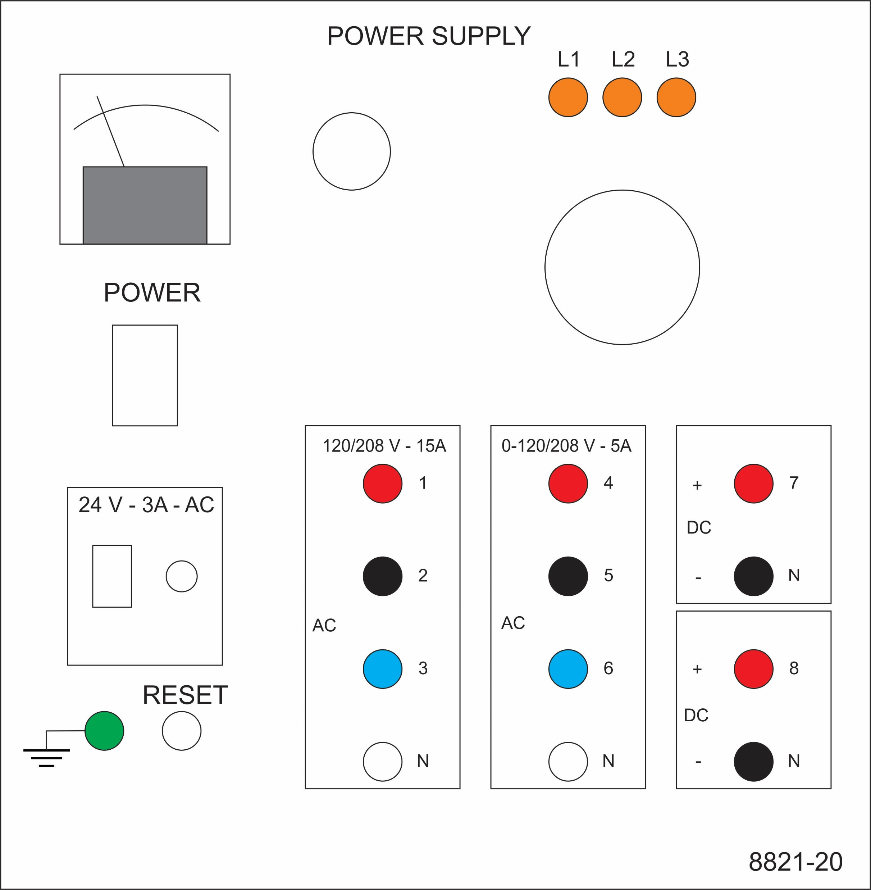
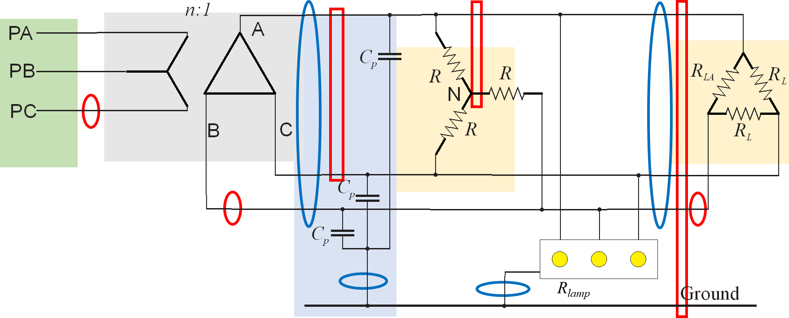
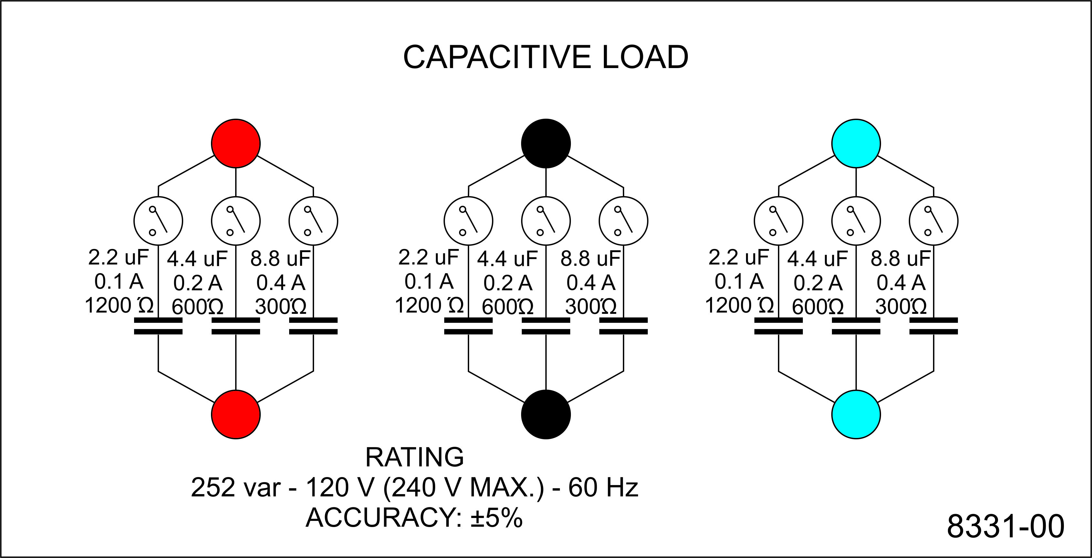
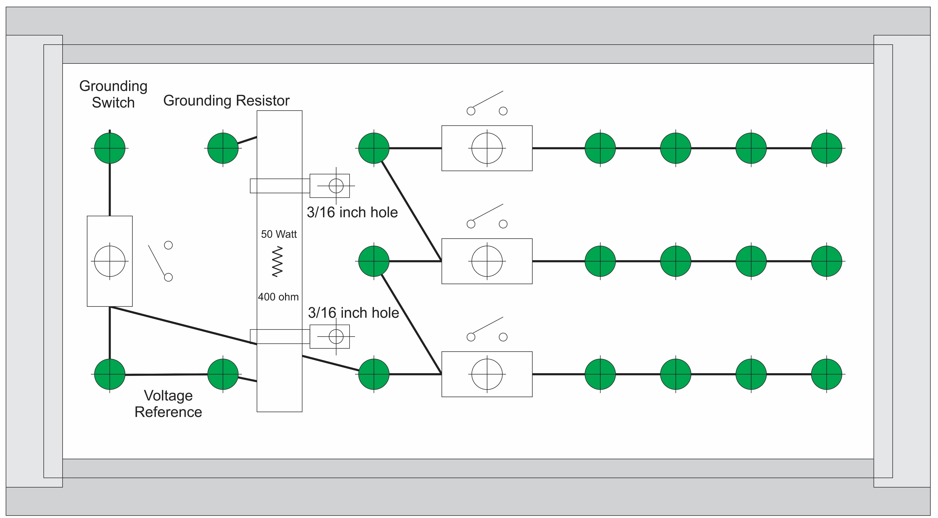
Experiment 4
Secondary - LL
Secondary - LN
Secondary - LG
Primary line
Secondary line
Load line
Wye
Delta
Parasitic

Slide 4
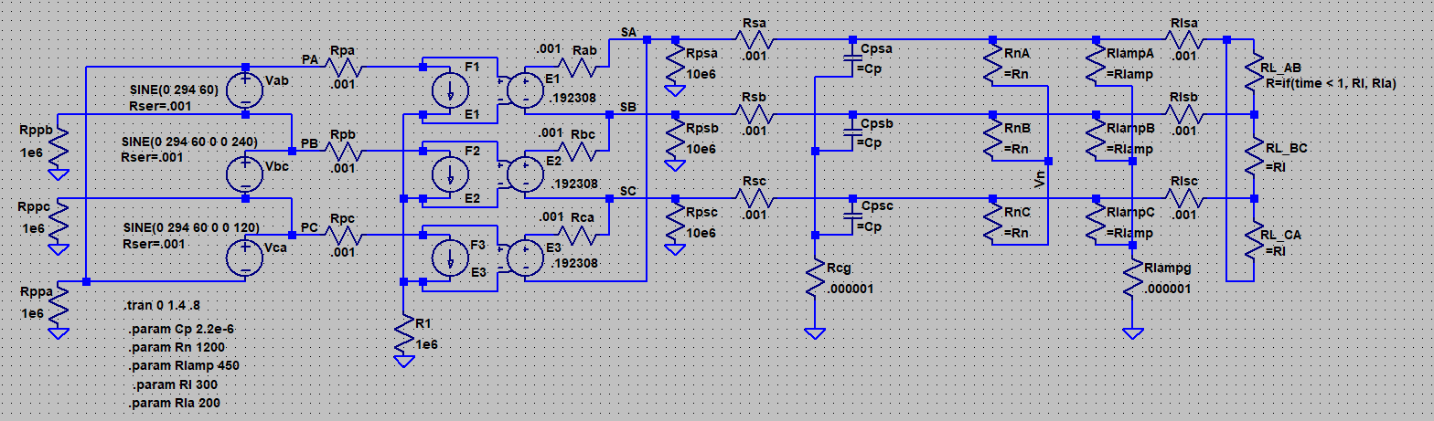
Simulation Model
LTspice
20240831 experiment 4.asc

Slide 5
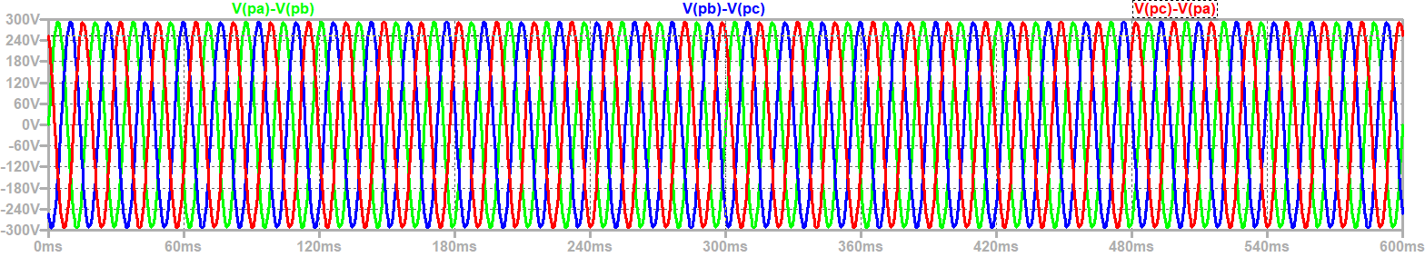
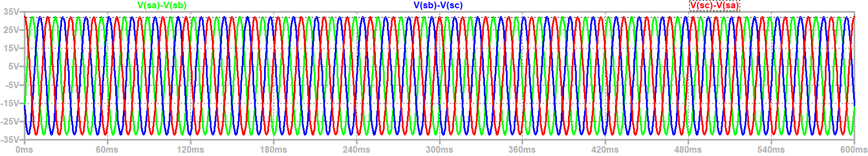
Steady State Voltages
$$V_{secondary_ll}=\frac{1}{n\sqrt{3}}V_{primary}=\frac{1}{5.2\sqrt{3}}208=23 volts rms (32.7 peak)$$
Primary Line to Line Voltage: Peak = 294 volts
Secondary Line to Line Voltage: Peak = 32.7 volts

Slide 6
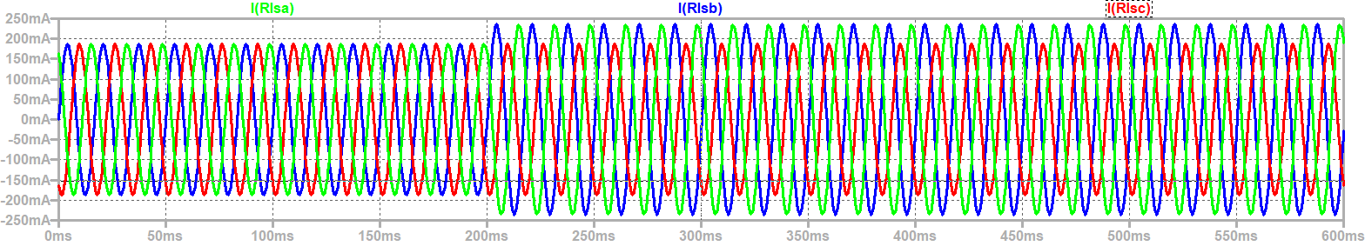
Line currents into the delta load not balanced with unbalanced load
Balanced Load Unbalanced Load

Slide 7
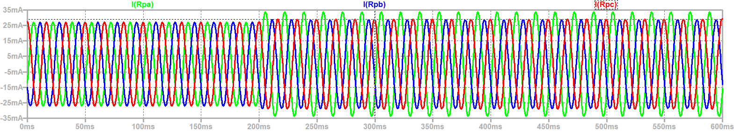
Line Currents on Primary are also not balanced with unbalanced load
Balanced Load Unbalanced Load

Slide 8
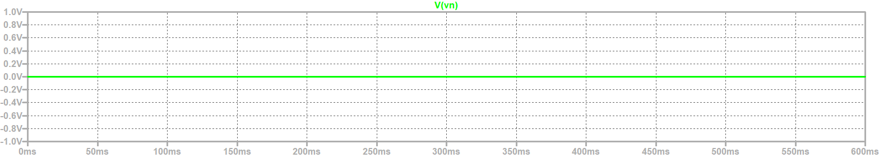
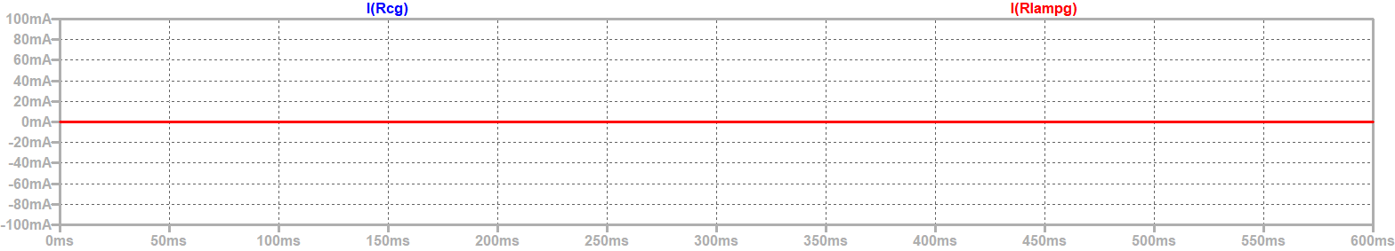
No neutral to ground voltage
(CM Voltage) or CM Current through Parasitic Capacitances or lamp resistances
Neutral to Ground Voltage
Balanced Load Unbalanced Load
CM Current through Parasitic Capacitances and Lamp Resistors

Slide 9
Wrap Up

